Slide 1
SEATTLE ACCIDENT COLISSION ANALYSIS
Coursera Capstone Project – Sep 2020
By: Adeel Naim Khan

Slide 2
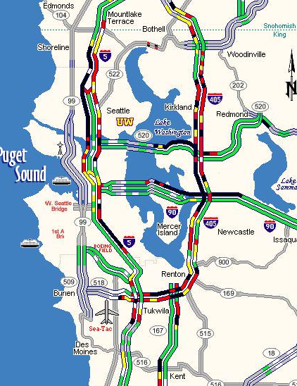
Introduction / Business Understanding
Predicting an accident collision based on the data collected is always challenging aspect of the data science topology. In our daily routine commuting, it is always advisable to take the route which has less blockage or rush due to accidents. Our main purpose here is to build a model which can predict a model to assist the daily commuters avoiding these issues.
There are many factors which causes the accidents and to predict the pattern using these factors can be very helpful to avoid such incidents. Imagine an accident occurring at a particular place or time many times and by analysis we find the relation of the occurrence of accident with factors which can be avoided or warned against.
This will be highly beneficial for authorities to take necessary steps and implement a plan for drivers to avoid it from happening in future.
Map pic by Chris Daniels

Slide 3
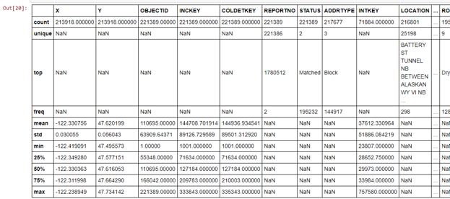
Data understanding
Data Source: http://data-seattlecitygis.opendata.arcgis.com/datasets/5b5c745e0f1f48e7a53acec63a0022ab_0.csv?outSR={%22latestWkid%22:2926,%22wkid%22:2926}
Total number of 40 variables available with 221389 data values.
Main aim for the project is to predict the SEVERITY of accidents in Seattle, based on the data provided it was considered as dependent variable.
Different attributes like Weather, Road conditions, Light conditions, physical coordinates, Types of junctions are considered as independent variables which helped to predict the Severity of the accident.

Slide 4
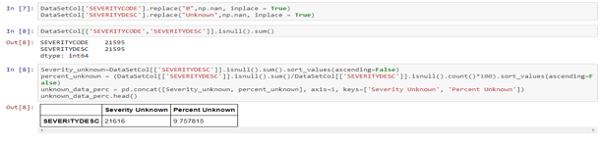
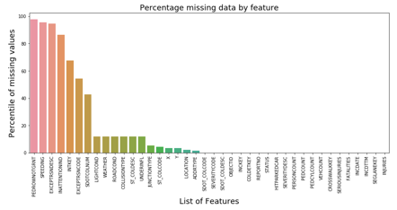
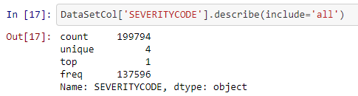
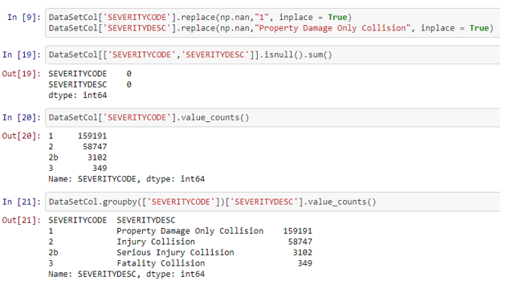

Data Preparation / analysis
Many columns have high number of missing values.
Columns with missing percentile greater than 40 were immediately removed
Variable SEVERITYCODE was Normalized by replacing “Unknown” value category with “Property Damage only Collision category”
Other columns which had less than 15% of missing data were either removed (based on their no direct relationship with Severity Code) or their missing values were replaced with the Top value of the attribute.

Slide 5
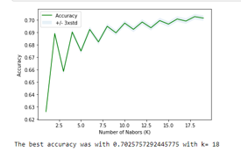
MODEL TECHNIQUES
Following 3 Models are utilized
KNN
  The K-Nearest Neighbours algorithm is a classification algorithm that takes a bunch of labelled points and uses them to learn how to label other points.
  A method of classifying cases, based on the similarity of other cases. Cases that are near each other are said to be neighbours.
Decision Tree
  The basic intuition behind a decision tree is to map out all possible decision paths in the form of a tree.
  Decision trees are about testing an attribute and branching the cases based on the result of the test.
Logistic Regression
  It is a classification algorithm for categorical variables
  It is analogous to linear regression but tries to predict a categorical or discrete target field instead of numeric one.

Slide 6
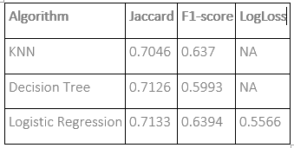
Prediction result
Accuracy of the Model is attained through calculating the following Metrics
F1- Score
Jaccard Score
Log Loss

Slide 7
conclusion
From the results of their accuracy models, we can see that all of them experienced accuracy of more than 70% which is a good indication based on the huge data we received.
From Evaluation point of the view, we can see the Jaccard set Accuracy for all of them is also greater than 70%, which is also a good sign and proves the confidence on our working model. F1 Score for KNN is around 63% whereas for Decision Tree and Logistic Regression it is around 59%. We can consider this as acceptable.
This model can help predict the severity of the accidents based on factors considered as Road condition, Light conditions, Weather conditions, Junction types and physical location of the accident area.

